Slide 1
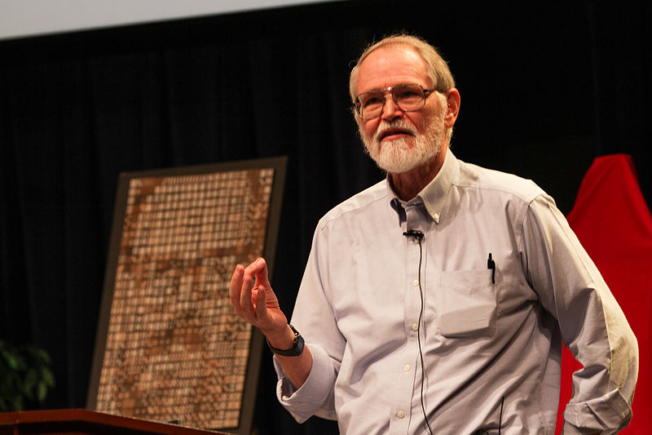
Brian Wilson Kernighan

Slide 2
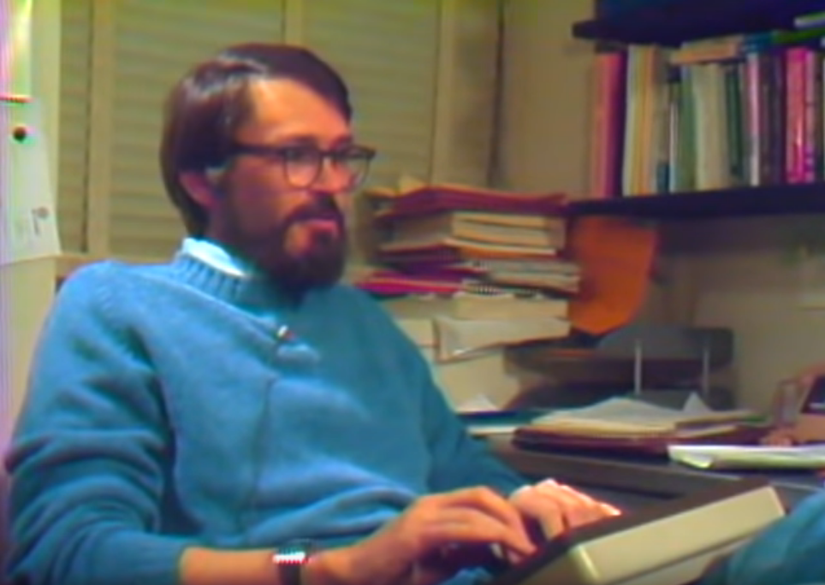
Was born on the 1st of January, 1942 in Toronto, Canada.
In 1960-1964 studied in the University of Toronto, where has got bachelor’s degree in engineer physics. Has got PhD degree in the University of Princeton in 1969 after
completing his doctoral dissertation entitled “Some problems of graph splitting connected with program segmentation” led by Peter G. Weiner.

Slide 3
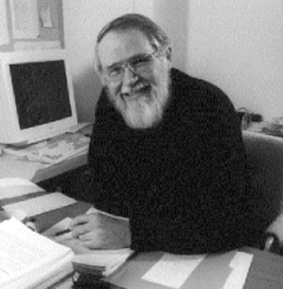
In 1969 he started working in Bell Labs – large research center in the sphere of telecommunications, electronic and computer systems – where his area of interests were program utilities, programming languages and optimization problems. He took part in creating AMPL – language for describing and solving difficult problems of optimization and timetable theory, - AWK (K if for Kernighan) – C-like script language, - programming tools and books for RatFor (Rational FORTRAN) and Pascal. He developed C language with Dennis Ritchie and wrote the first book about it.
Also he has written “The Go Programming Language”, “The Practice of Programming”, “Why Pascal isn’t my favorite programming language”

Slide 4
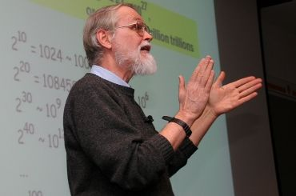
Is a professor in the Computer Science Department at Princeton since 2000. Every autumn he teaches a course "Computers in our World", which introduces the basics of computing to non-core specialists.
He was a software editor for Prentice Hall International – large American publisher specializing on educational materials. His series "Software Tools" reveals the essence of "C/Unix thinking" with changes for BASIC, FORTRAN and Pascal, and first of all his "Ratfor" were transferred to the public domain.
In 1996 he taught CS50 (Computer Science 50) – course for students of Harvard.
Is a member of National Engineering Academy since 2002
Is the creator of “UNIX” term and popularizer of the UNIX philosophy.

Slide 5
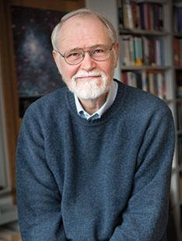
Quotes
The only way to learn a new programming language is to write programs in it
Debugging code is twice as difficult as writing it. So if you wrote the code as smart as you could, then you're definitely not smart enough to debug it.
Managing complexity is the essence of computer programming.
C is a razor-sharp tool with which you can create both an elegant program and a bloody mess.
Among the variety of interfaces, constantly changing languages, utilities and systems, under constant pressure of circumstances, we very often forget about the main principles that should be the basis of any good program - simplicity, clarity and versatility

